Slide 1

Object Oriented Programming
A Tale of Constructors
IT560
Sourish Dasgupta
Assistant Professor, DA-IICT, Gandhinagar
https://daiict.ac.in/faculty/sourish-dasgupta

Slide 2
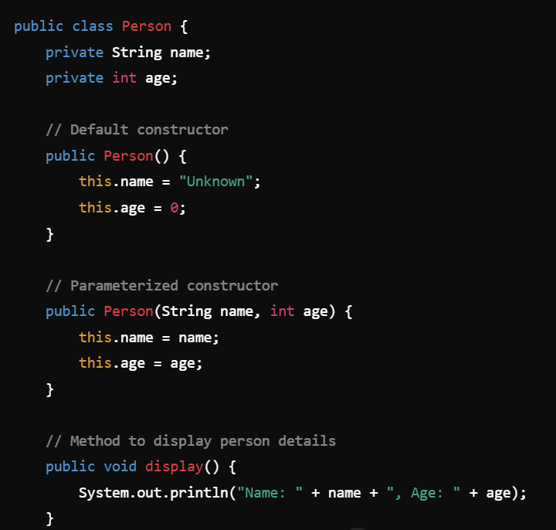
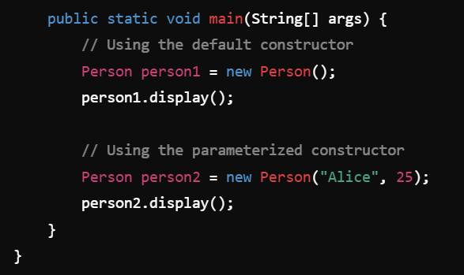
Guess the language?
IT560: A Tale of Constructors
Sourish Dasgupta

Slide 3
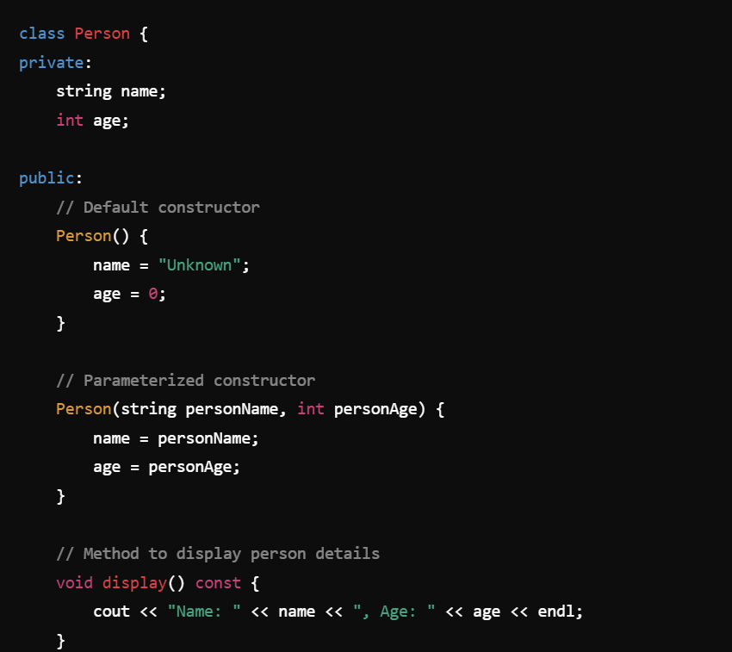
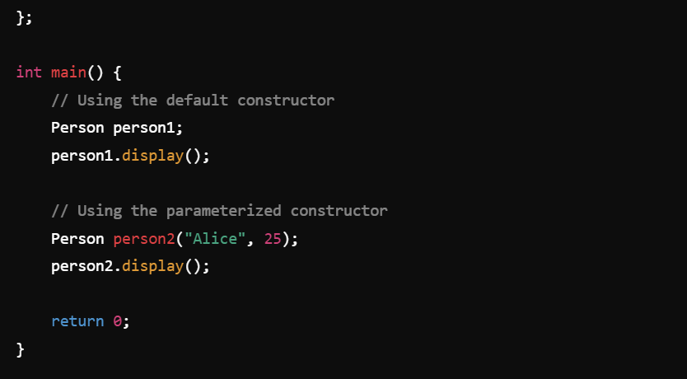
Guess the language?
IT560: A Tale of Constructors
Sourish Dasgupta

Slide 4
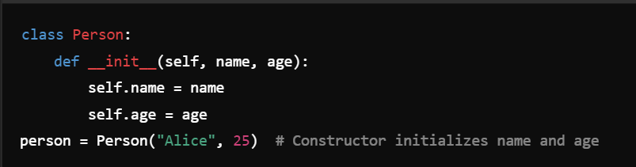
Guess the language?
IT560: A Tale of Constructors
Sourish Dasgupta

Slide 5
Why Constructors? OOP begins at home!
Purpose | Description
Object Initialization | Sets up the initial state of an object by initializing its attributes
Encapsulation | Hides initialization details, ensuring proper setup and reducing errors
Abstraction | Simplifies object creation by abstracting the setup logic
Code Reusability | Enables consistent reuse of initialization logic for multiple objects
IT560: A Tale of Constructors
Sourish Dasgupta

Slide 6
Why Constructors? OOP begins at home!
Purpose | Description
Automatic Invocation | Ensures the constructor is called automatically when an object is created
Custom Behavior | Allows defining specific behaviors (e.g., validations, derived properties) during object creation
Overloading | (In some languages) Provides flexibility by allowing multiple ways to initialize an object
Improved Readability | Enhances code clarity and usability by standardizing object creation and initialization
IT560: A Tale of Constructors
Sourish Dasgupta

Slide 7
Are Constructors good enough?
IT560: A Tale of Constructors
Sourish Dasgupta

Slide 8
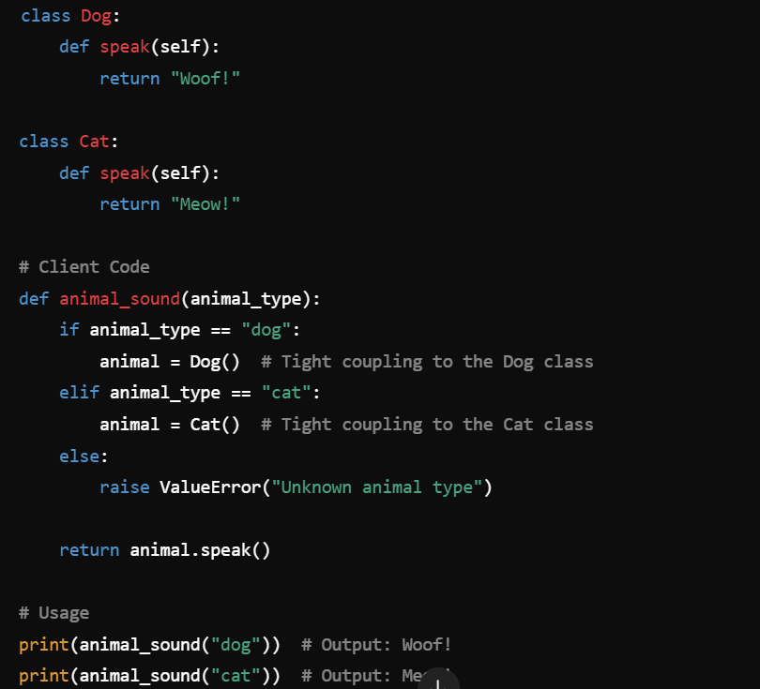
What’s wrong with this?
IT560: A Tale of Constructors
Sourish Dasgupta

Slide 9
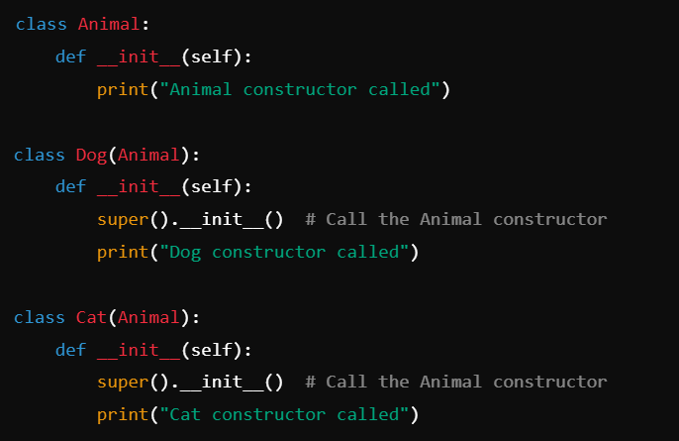
Explicit Constructor is not needed if no setup needed
Optional!
IT560: A Tale of Constructors
Sourish Dasgupta

Slide 10
But there’s something genuinely problematic!
Adding a new animal type requires modifying animal_sound, violating the Open-Closed Principle (OCP)
The function is limited to the specific classes (Dog and Cat) and cannot handle new types dynamically
Mocking or replacing Dog or Cat in tests is difficult because they are hardcoded
Tight Coupling!
IT560: A Tale of Constructors
Sourish Dasgupta

Slide 11
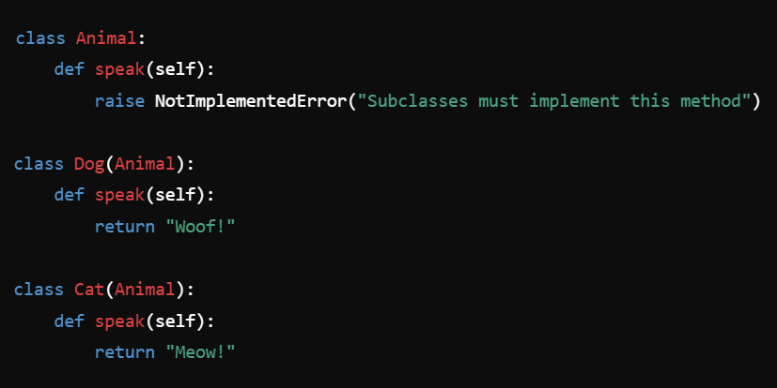
Decoupling Constructors
IT560: A Tale of Constructors
Sourish Dasgupta

Slide 12
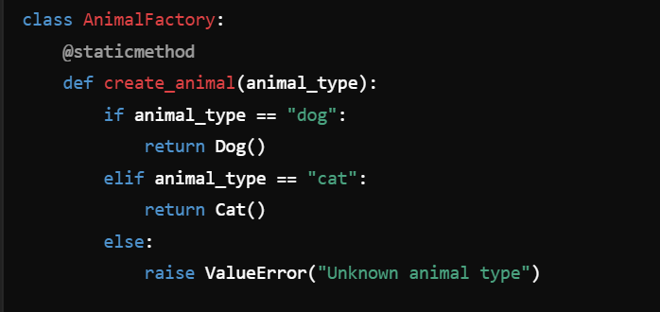
Decoupling Constructors
Adding a new animal type (e.g., Bird) requires only modifying the AnimalFactory without changing animal_sound.
No longer directly depends on the Dog or Cat classes. It delegates object creation to the AnimalFactory.
IT560: A Tale of Constructors
Sourish Dasgupta

Slide 13
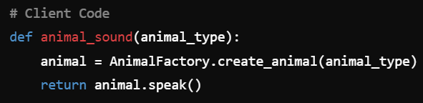
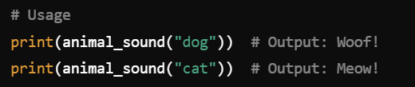
Decoupling Constructors via Factory Design Pattern
No longer directly depends on the Dog or Cat classes. It delegates object creation to the AnimalFactory.
IT560: A Tale of Constructors
Sourish Dasgupta

Slide 14
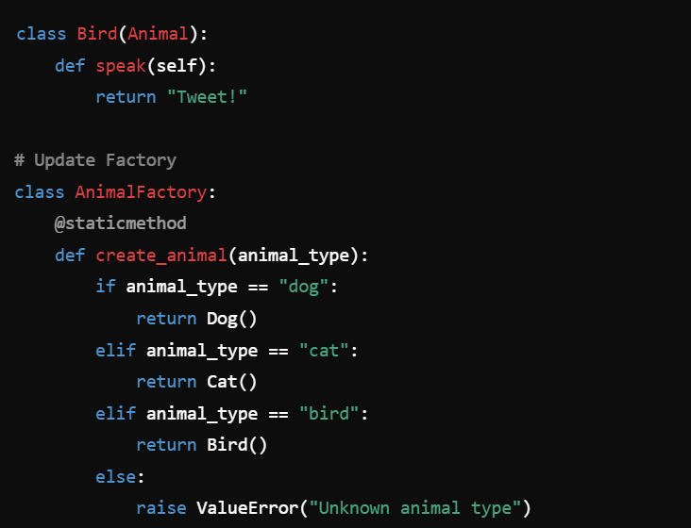
Achieving Open-Closed Principle (OCP)
Open for Extension:
Add new functionality to the module (e.g., new features or behaviors)
Closed for Modification:
The existing code of the module should not be modified when adding new functionality
IT560: A Tale of Constructors
Sourish Dasgupta

Slide 15
A bit about Static Methods …
Utility Functions:
Need a helper function related to the class but not dependent on instance or class-level data
Encapsulation:
To group related logic within the class for better readability and organization
Factory Methods:
To create objects or perform operations that don't need access to instance or class-specific data
Decorator
IT560: A Tale of Constructors
Sourish Dasgupta

Slide 16
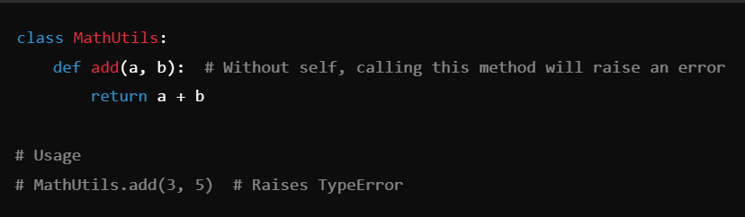
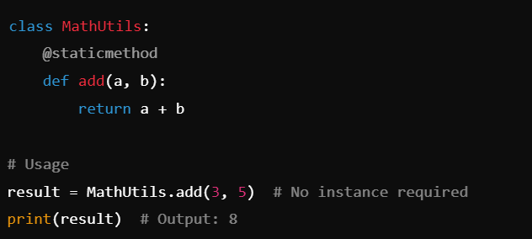
A bit about Static Methods …
Utility Functions:
Need a helper function related to the class but not dependent on instance or class-level data
Encapsulation:
To group related logic within the class for better readability and organization
Factory Methods:
To create objects or perform operations that don't need access to instance or class-specific data
Decorator
IT560: A Tale of Constructors
Sourish Dasgupta

Slide 17
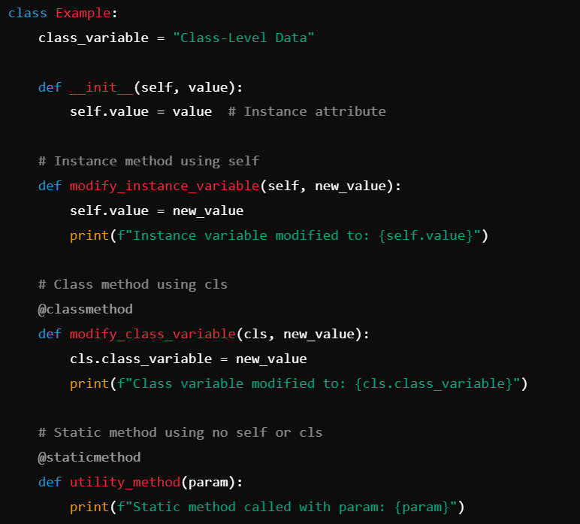


Meet its cousins - self and @classmethod
IT560: A Tale of Constructors
Sourish Dasgupta

Slide 18
Animal is inherited by Dog and Cat as “Base Class”
IT560: A Tale of Constructors
Sourish Dasgupta

Slide 19
Why the base class Animal?
IT560: A Tale of Constructors
Sourish Dasgupta

